Slide 1

MCO OER Initiative

Slide 2

Agenda
Defining Open Educational Resources
It’s About Student Success
MCO OER Initiative
MCO OER Repository
How to start
Question & Answer

Slide 3
Defining OERs
Open Educational Resources (OERs) are any type of educational materials that are in the public domain or introduced with an open license. The nature of these open materials means that anyone can legally and freely copy, use, adapt and re-share them. OERs range from textbooks to curricula, syllabi, lecture notes, assignments, tests, projects, audio, video and animation.
Source: United Nations Educational, Scientific and Cultural Organization (UNESCO)

Slide 4
The 5R Permissions of OER
Retain
Make and own copies
Reuse
Use in a wide range of ways
Revise
Adapt, modify and improve
Remix
Combine two or more
Share with others
Redistribute

Slide 5
Creative Commons
Copyright licenses and tools to give creators a simple standardized way to grant copyright permissions to their work.
Source – Creativecommons.org
CC BY Attribution | CC BY-SA Attribution ShareAlike
CC BY-ND Attribution-NoDerivs | CC BY-NC Attribution-NonCommercial
CC BY-NC-SA Attribution – NonCommercial-ShareAlike | CC BY-NC-ND Attribution – NonCommercial-NoDerivs

Slide 6
OER - Benefits
Fosters pedagogical innovation and relevance that avoids teaching from the textbook
Broadens use of alternatives to textbooks while maintaining instructional quality
Lowers costs of course materials for students
Provides opportunities to share and remix learning materials for customized and localized use
Fast feedback loop leading to continual improvement and rapid development

Slide 7
OER - Challenges
Some materials may not meet Section 508 ADA accessibility
No common standard for review of OER accuracy and quality (open textbook review criteria)
Customization necessary to match departmental and/or college curriculum requirements
Technical requirements to access vary

Slide 8
The Best Reason
Student Success –
Completion
Passing with a C- or better grade
Course grade
Enrollment Intensity in current term
Enrollment Intensity in next term
Source: A multi-institutional study of the impact of open textbook adoption on the learning outcomes of post-secondary students. Lane Fischer , John Hilton III, T. Jared Robinson, David A. Wiley. http://tinyurl.com/q2dp6na

Slide 9
MCO Initiative
Goals:
Improving student success
Lowering costs for students
Increasing inter-institutional faculty collaboration

Slide 10
MCO Initiative
Statewide Steering Committee
Training/webinars
Data Collection
Mini-grants
Repository

Slide 11
MCO Repository
Hosted by OER Commons
Connection to over 65,000 resources
Low maintenance costs
Authoring tools
Training

Slide 12
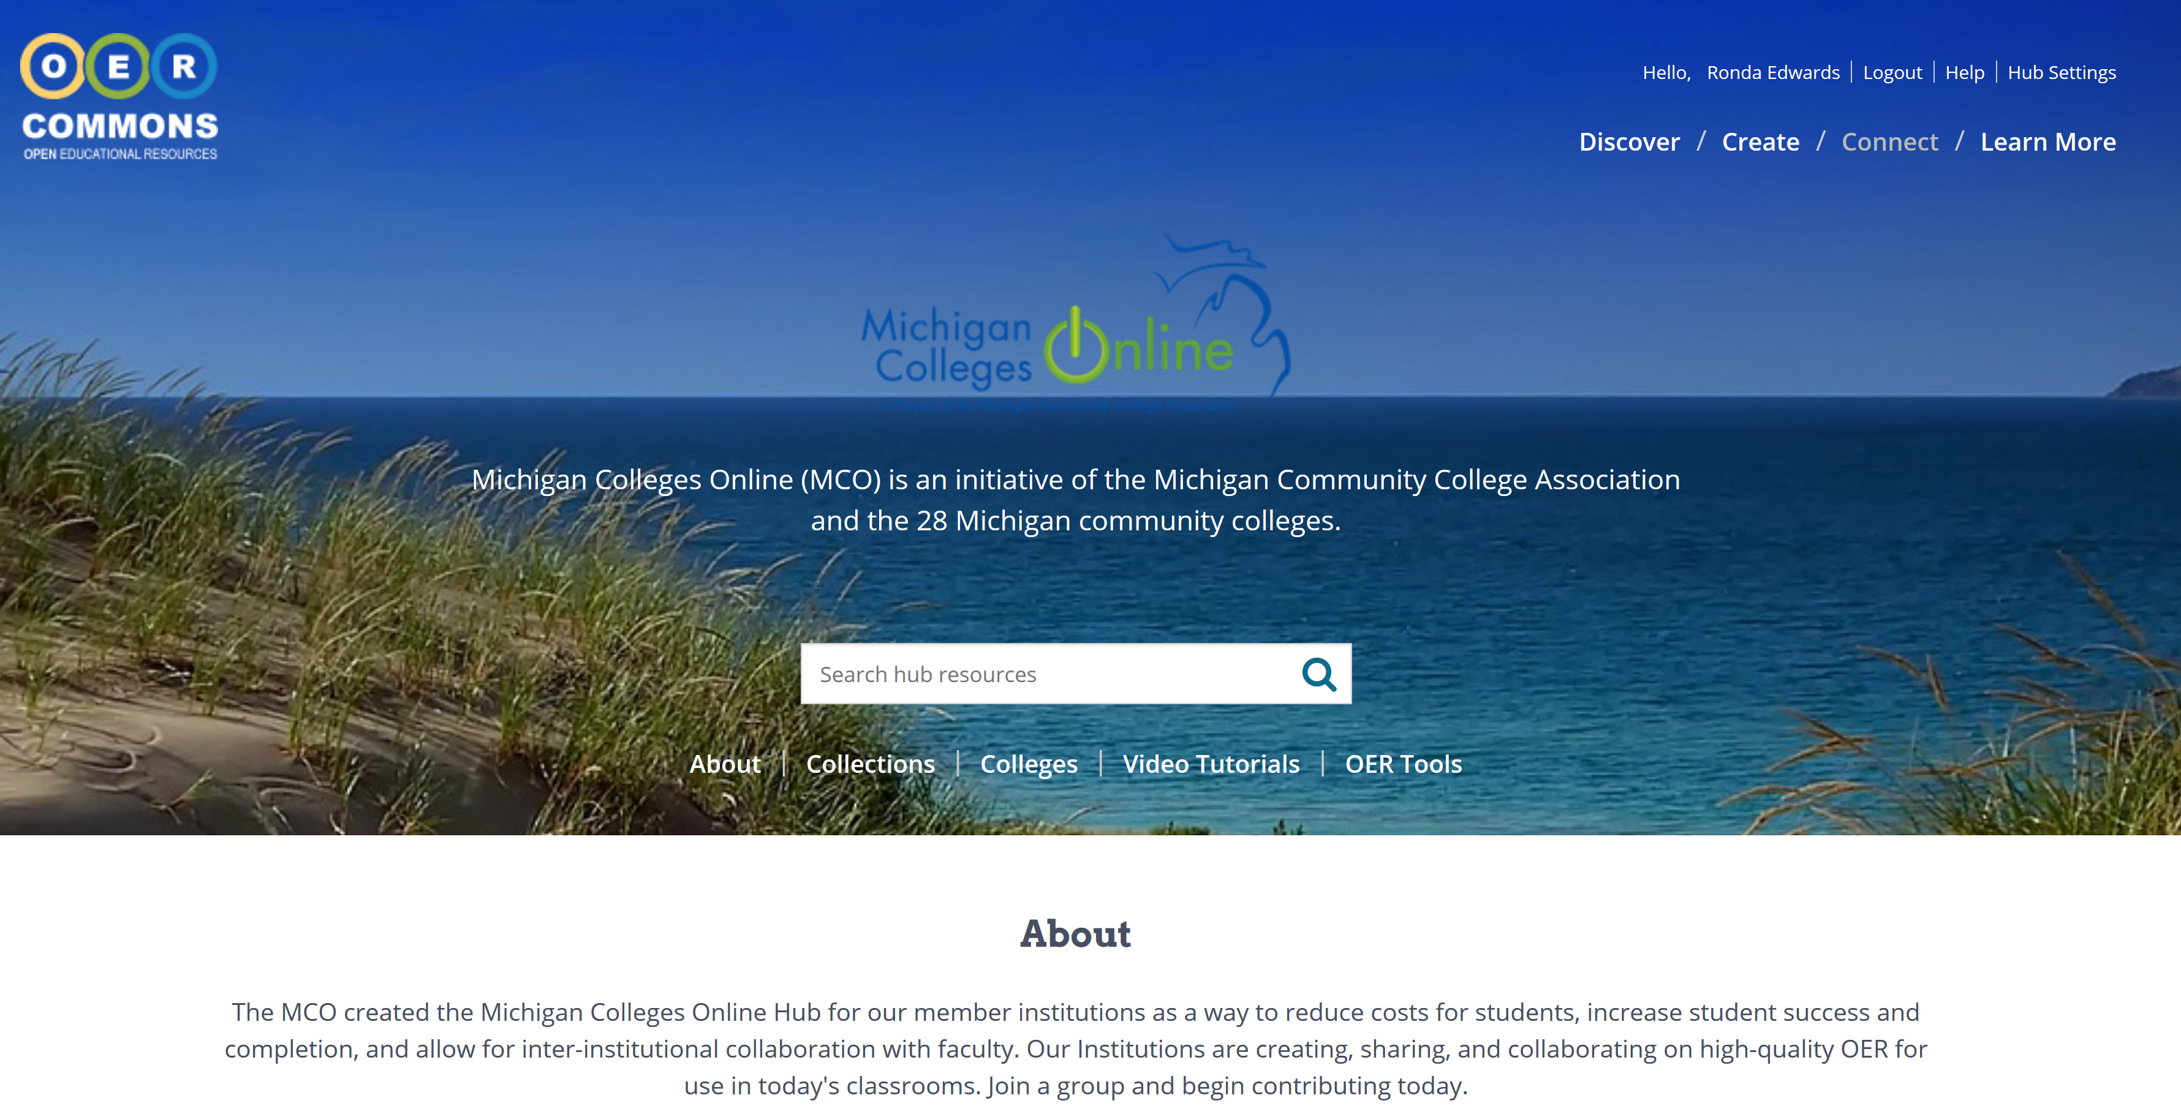
https://www.oercommons.org/hubs/mco

Slide 13











OER Commons Digital Public Library
Expertly curated collections from over 400 content providers, over 65,000 resources
Custom technical web infrastructure and supports for educators at all levels
Integration with state and local LMS’s and processes
Content hosted on OER Commons as well as on external sites.
Platform for creating, collaborating, and remixing OER.
Mature platform leverages best practices in library science, tagging and schema protocols, metadata standards and interoperability

Slide 14
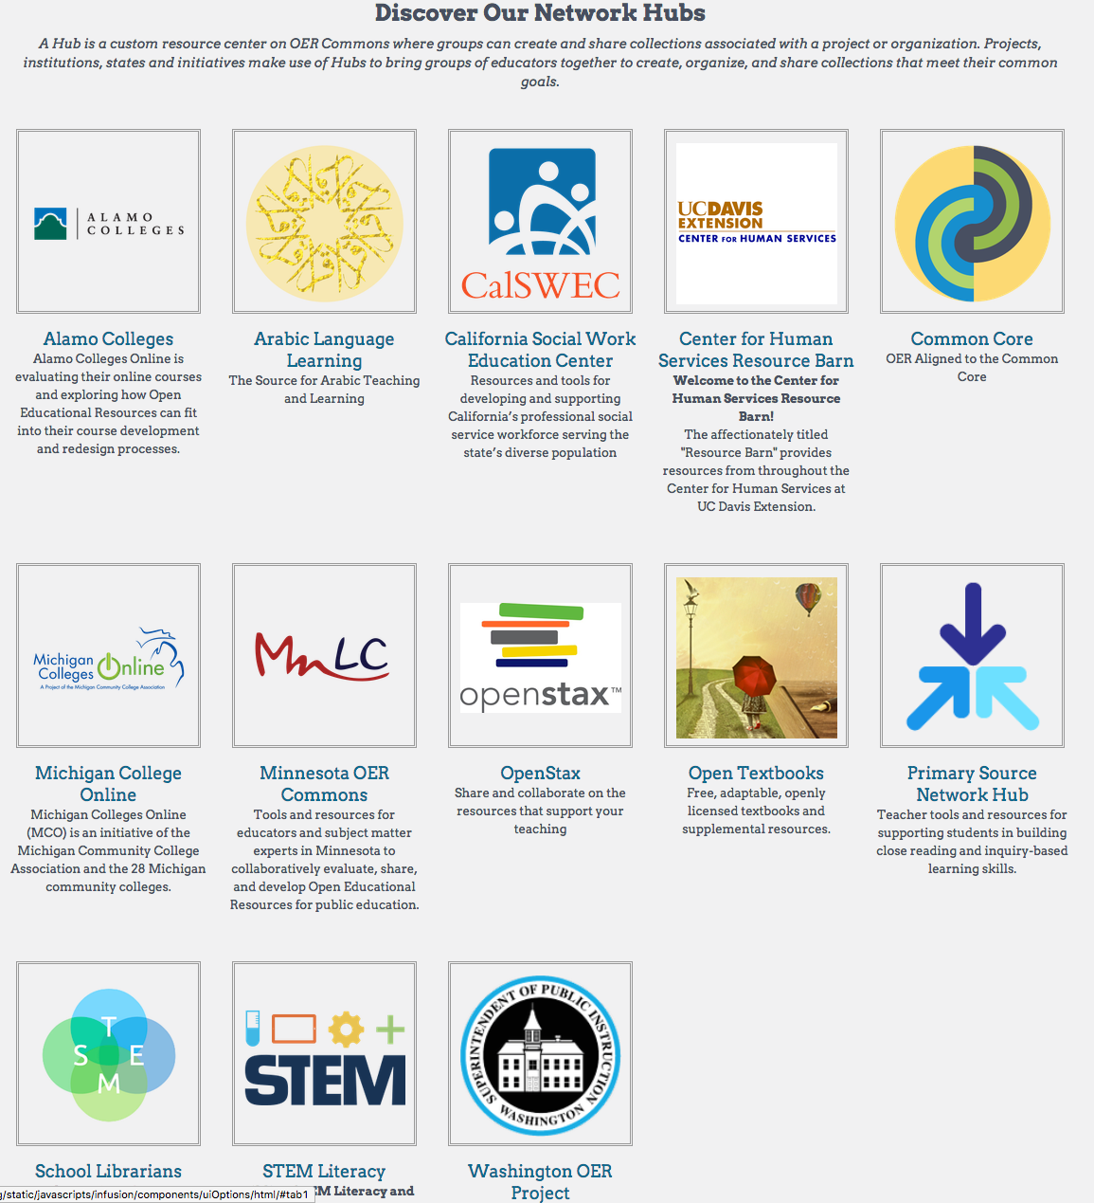
The OER Commons Hubs

Slide 15
The OER Commons Hub
A Hub is a centralized location on OER Commons where an organization can aggregate and collect specific Collections, Groups, or Resources.
ISKME creates Hubs to help users find resources emphasizing a specific topic.
Open Textbooks
STEM Literacy
Common Core
A Hub is a way for an organization to highlight high quality, vetted OER for members.

Slide 16
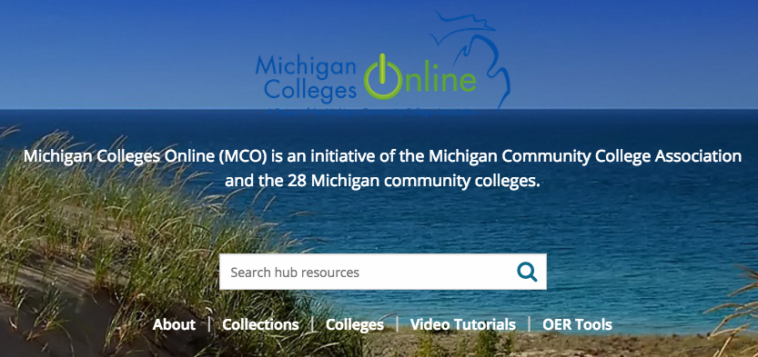

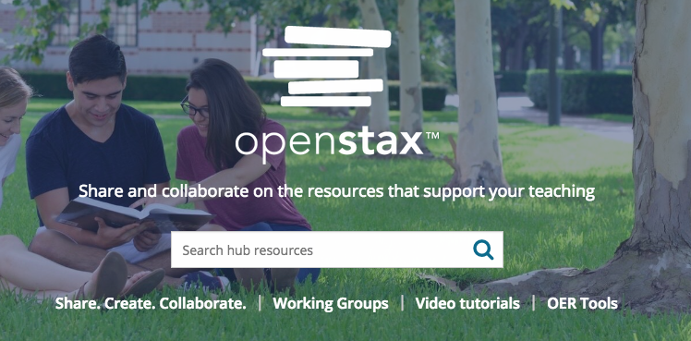
The OER Commons Hubs
Statewide Hubs
Michigan Colleges Online
Minnesota OER Commons
Washington OER Project
Alamo Colleges
Topical Hubs
Open Textbook Hub
Common Core
STEM Literacy
OER Commons Partner Hubs
OpenStax

Slide 17

Search a Hub
The OER Commons Hub: Vetted Resources
Within a Hub, anyone can search the resources that have been curated into collections. Search also includes resources that are saved to Groups highlighted on a Hub.

Slide 18
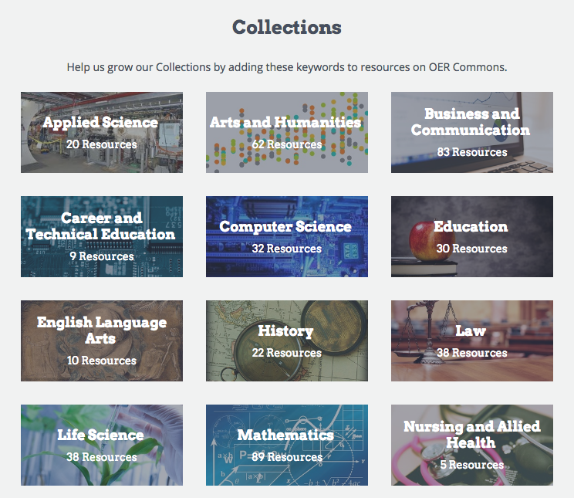
Search a Hub
The OER Commons Hub: Highlight Topics
Working with the team at OER Commons, a Hub can have content collections curated specifically for the Hub audience. Additionally, unique keywords can be used to further populate a Collection.

Slide 19
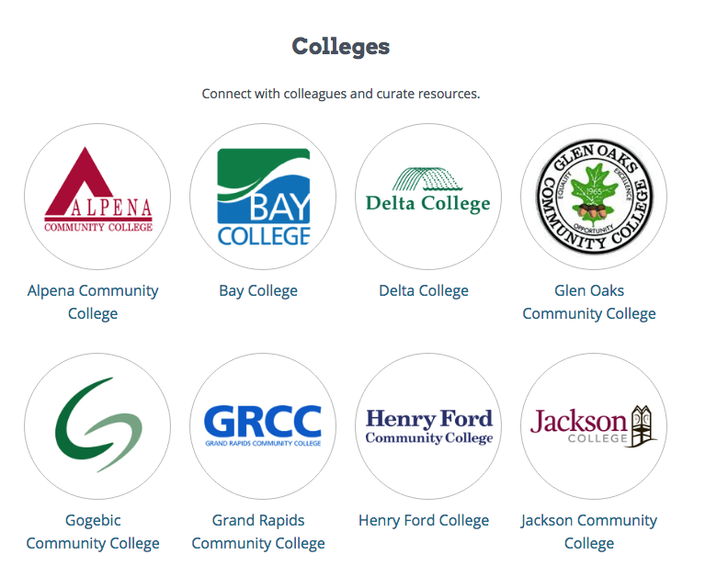
Search a Hub
The OER Commons Hub: Collaborate
Groups can be highlighted on a Hub. A Group is a community of practice on OER Commons where members can curate resources, organize them, collaborate on authoring, and hold discussions using the Discussion board.

Slide 20
The OER Commons Toolset: Groups
Anyone can look at another Group’s collections.
Get ideas about resources that are in use by others.
Find resources that are newly added to Groups of interest.
Access your Group via your LMS
We offer LTI access to a Group so all your curated resources are easily added to your LMS.
Add Groups to Your Hub
Aggregating Groups on a Hub creates a sense of community and shared purpose.

Slide 21
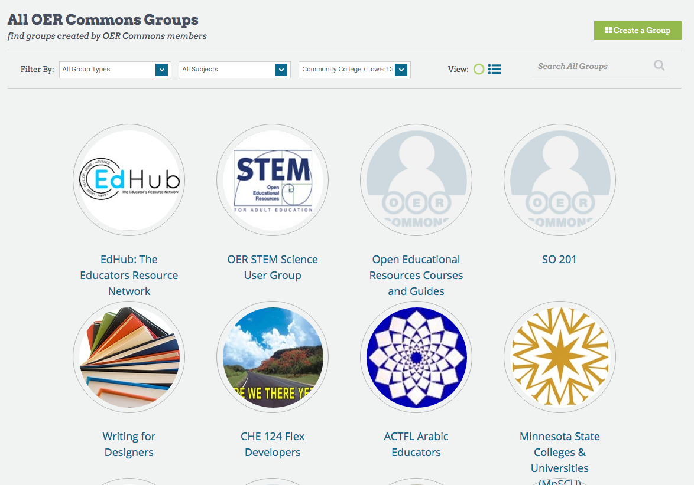
The OER Commons Groups

Slide 22
The OER Commons Groups
Any registered user can create an OER Commons Group.
Groups provide a space for people to collect, curate, and organize OER.
Create your own folder structure
Save resources to your Group
Work with others to create and suggest new resources for a Group.
Engage in Discussions with other Group members.

Slide 23

Resource Organization
Subject Areas
Education Levels
Material Types
Media Formats

Slide 24
Conditions of Use
No strings attached – no restrictions, give credit to the author as required.
Remix and Share – any changes come with some restrictions including how it is shared.
Share only – can’t make changes
Read the fine print – everything else – such as Fair Use/TEACH Act.
Notes:
No Strings Attached No restrictions on your remixing, redistributing, or making derivative works. Give credit to the author, as required. Includes Public Domain, Creative Commons Attribution (CC BY), Creative Commons Public Domain, and any item that explicitly says no restrictions.
Remix and Share Your remixing, redistributing, or making derivatives works comes with some restrictions, including how it is shared. Includes Creative Commons Attribution Share Alike (CC BY-SA), Creative Commons Attribution NonCommercial Share Alike (CC BY-NC-SA), Creative Commons Attribution NonCommercial (CC BY-NC), GNU Free Documentation License (GFDL), WGBH Teachers' Domain remix.
Share Only Your redistributing comes with some restrictions. Do not remix or make derivative works. Includes Creative Commons No Derivatives (CC ND), WGBH Teachers' Domain share.
Read the Fine Print Everything else. All Rights Reserved. US-based educators have certain permissions under Fair Use and the TEACH Act. Includes educational and personal uses of copyrighted materials, custom licenses and terms, permission to print only, unknown restrictions, and any other redistribution restrictions of the DMCA and of your own country.

Slide 25
Member Tools
Tag – classify resources
Rate – mark the relevance and value
Review – provide a public review of a resource for others
Save – to a personal folder for easy access
Note – add a private note to an item, viewable only by you.
Contribute Content
Notes:
When you register with OER Commons or one of our sites, you can create a portfolio, review, tag, and rate items, and contribute your own content to the site.
Tag: Tags are words you use to classify a resource in a way that is helpful to you. Choose Tag This Item from the Actions dropdown in the search results, or from the right column of the individual resource.
Rate: You may rate a resource to mark the relevance and value of that resource. Choose Rate This Item from the Actions dropdown in the search results, or from the individual resource screen.
Review: You may write a review about resource, writing commentary about how you used the resource, the quality of the resource, and information about how others might use this resource. Reviews are public to all users. Choose Review This Item from the Actions dropdown in the search results, or from the individual resource screen.
Save: You may save an individual resource or a search query to your portfolio. Both of these functions help you easily access the resources at a later time. To save an individual resource, choose Save This Item from the Actions dropdown in the search results, or from the individual resource screen, in the right portal above the tags for that resource. To save a search, choose Save This Search from the search query, in the right portal above the tags for that search.
Note: You may add a private note to an item, viewable only by you, by choosing Add Notes at the bottom of an individual resource.
Contribute Content: You may submit open educational resources to OER Commons if you control the copyright or licensing, and if the materials are freely hosted online. OER Commons does not provide hosting of the actual items. To submit materials, click on the Contribute Content button at the top of any OER Commons page.

Slide 26
Before we start the tour…
Things to Consider:
Textbook policies (department/college)
Bookstore policies
Intellectual property policies (http://oerconsortium.org/policies-and-models/)
Talk to your librarians!

Slide 27
https://www.oercommons.org/hubs/mco

Slide 28
Questions?

Slide 29
Ronda Edwards
Executive Director
redwards@mcca.org

